Slide 1
Kali Linux Local Security Check Tool
Basic system reconnaissance and security audit on localhost
Sathwik Rao 2420030728
Adithya 2420030571

Slide 2
PROJECT PURPOSE
• Identify open ports and services
• Detect weak configurations
• Provide security reminders
• Verify system before pentesting

Slide 3
TOOLS USED
• ip addr → Network information
• ss → Listening ports
• nmap -sV localhost
• find -perm -4000 → SUID
• awk /etc/shadow
All built-in Kali Linux tools

Slide 4
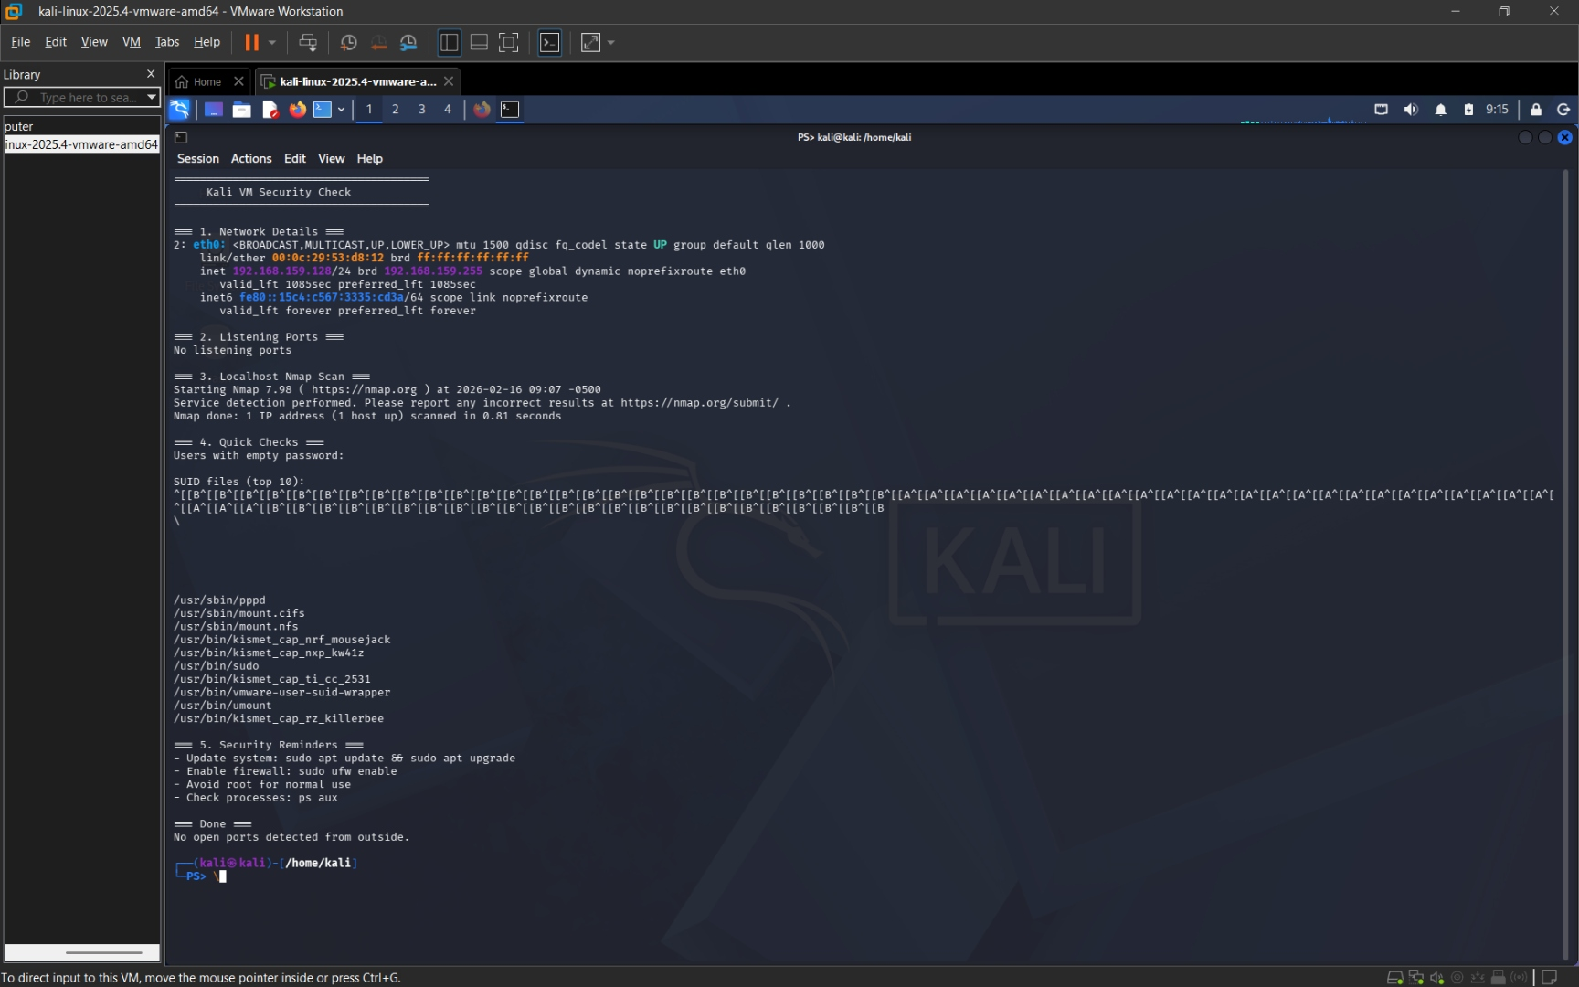

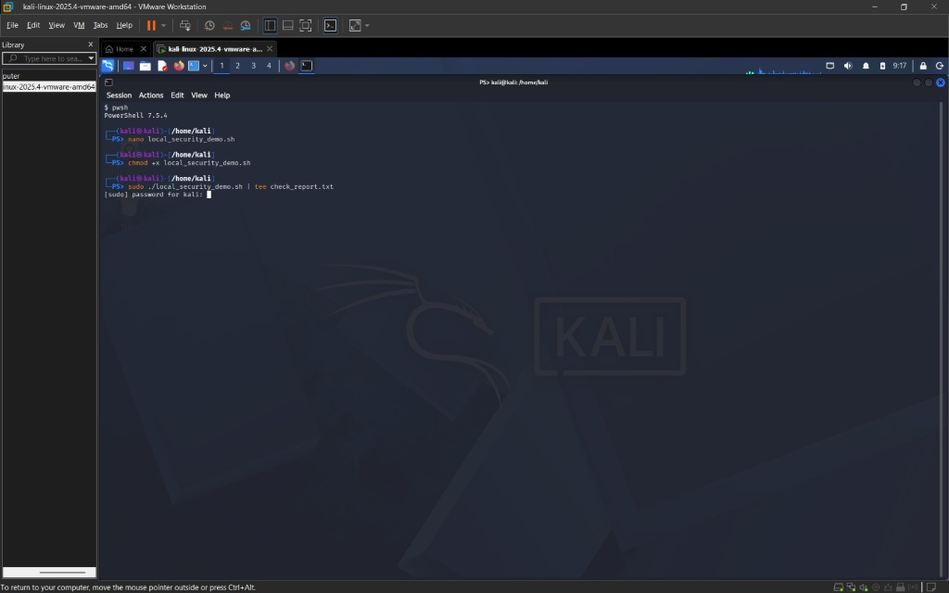
DEMO RESULTS
Network: eth0 192.168.159.128
Ports: None found
Nmap: 1000 ports closed
Kali VM well-hardened

Slide 5
SECURITY REMINDERS
• sudo apt update && sudo apt upgrade
• sudo ufw enable
• Avoid root for daily use
• Monitor processes (ps aux)
• Perform regular self-audits

Slide 6
CONCLUSION
• Lightweight local security script
• Ethical lab reconnaissance
Thank you

